Slide 1

Natural Language Processing

Slide 2

Introduction
Angus Roberts
Professor of Health Informatics
Institute of Psychiatry, Psychology and Neuroscience
King’s College London

Slide 3
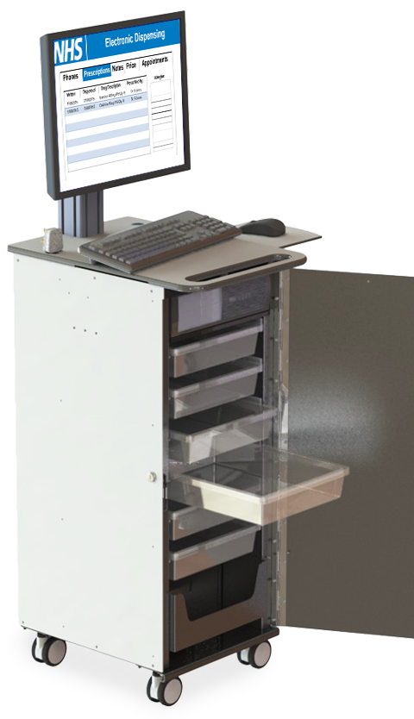

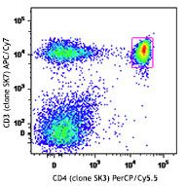
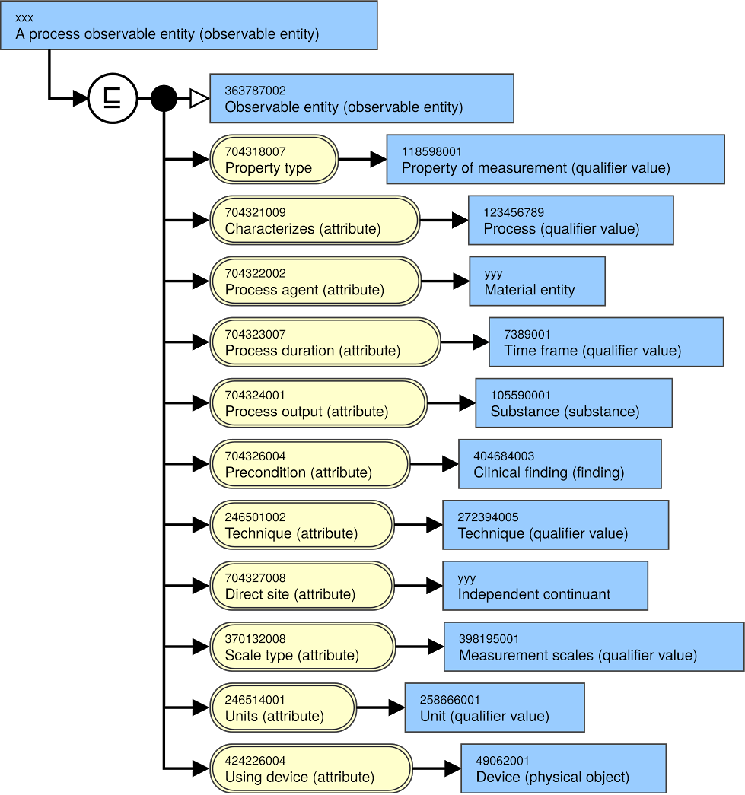

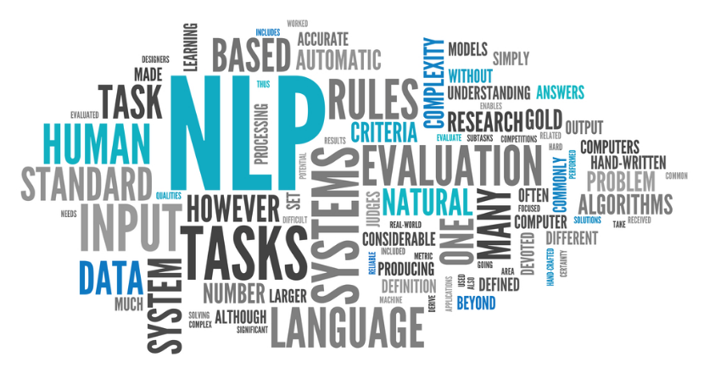
Introduction – my journey

Slide 4
Motivation – reusing the health record
Thomas Willis in “Dr. Willis’s Practice of Physick Being All the Medical Works of That Renowned and Famous Physician” 1684.
“weigh all the symptoms, and to put them, with exact Diaries of the Diseases, into writing; then diligently to meditate on these, and to compare some with others; and then [begin] to adopt general Notions from particular Events”
Reuse of the medical record
Computerisation of the record allows us to magnify the efforts of Willis by many degrees e.g. for
Observational studies
Trial recruitment
Case identification
Retrospective cohorts
Individual risk prediction

Slide 5
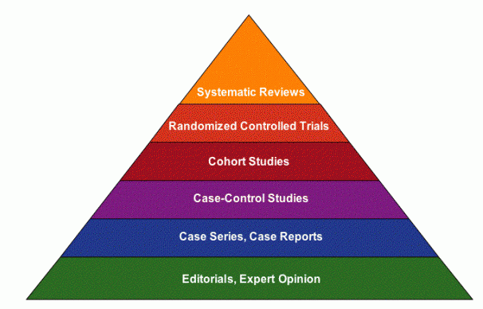
The pyramid of evidence
Reality
Strength of evidence

Slide 6
The pyramid of evidence
Observational
Relationship between exposure and outcome
Survey data
Routinely collected data
Reality
Strength of evidence

Slide 7
The pyramid of evidence
Real-world circumstances
Cheaper
Longer time spans
Risk-factors which would be unethical in an RCT
Exposures that cannot be randomized – e.g., schizophrenia
No problems with capacity and consent
Reality
Strength of evidence

Slide 8
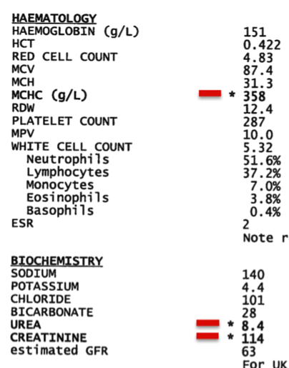
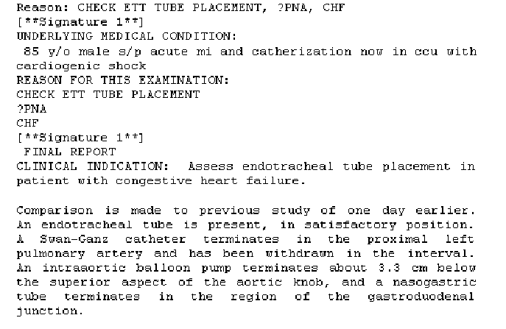
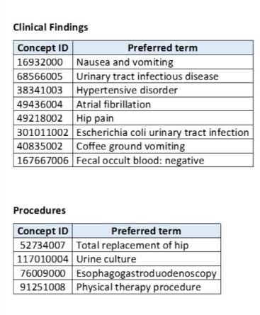
Electronic health records (EHRs) – structured and unstructured information

Slide 9
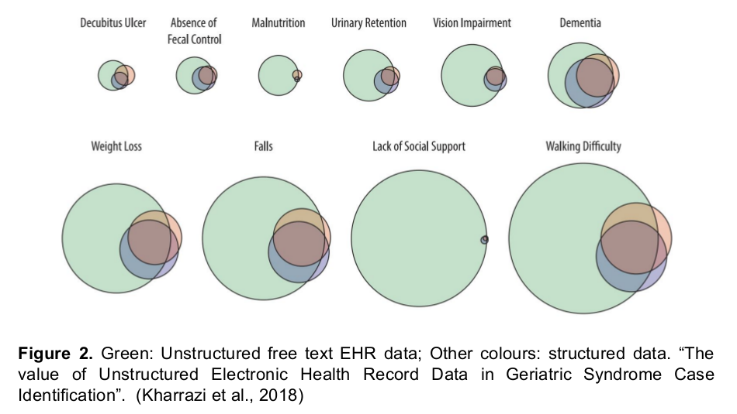
How much unstructured, textual information is in an EHR?

Slide 10
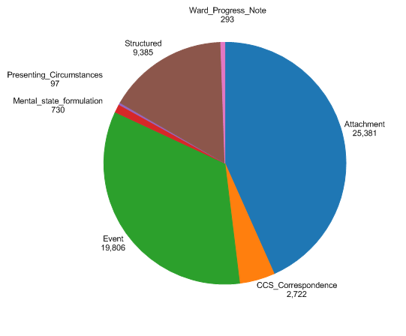
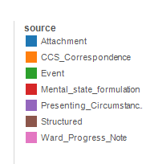
An example – Mini Mental State Examinations

Slide 11
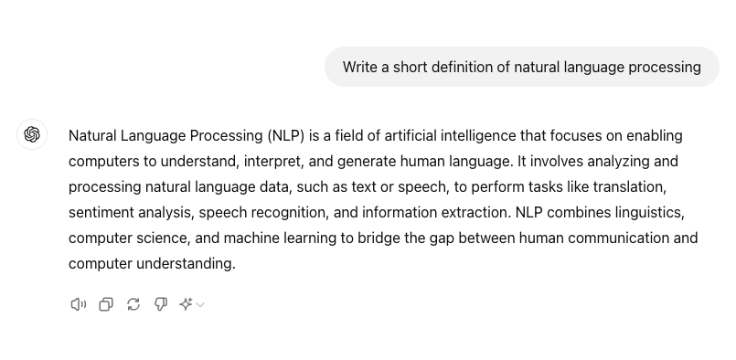

Natural Language Processing

Slide 12
Natural Language Processing
plus
Search
Question answering
Summarisation
Document classification
Dialogue

Slide 13
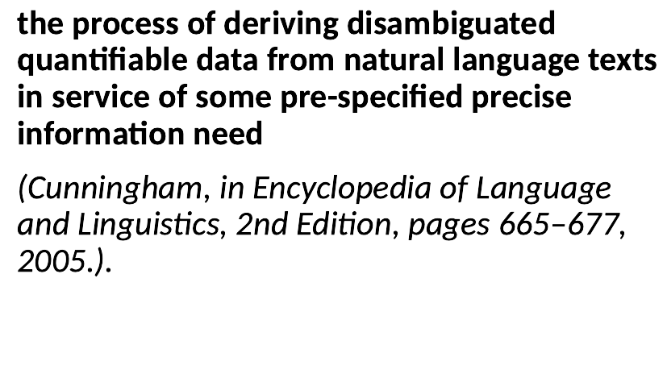
Information extraction

Slide 14
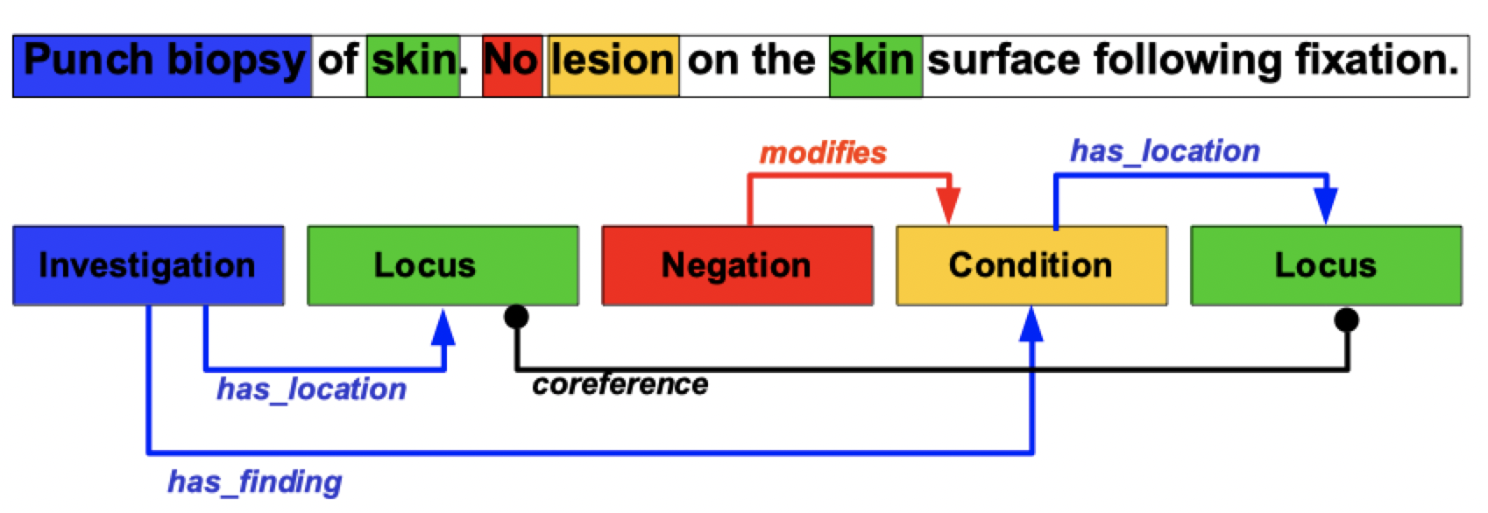
Information extraction
We might extract:
Entities and their co-referents
Negation, certainty
Relations
Events
Temporal expressions and relations

Slide 15
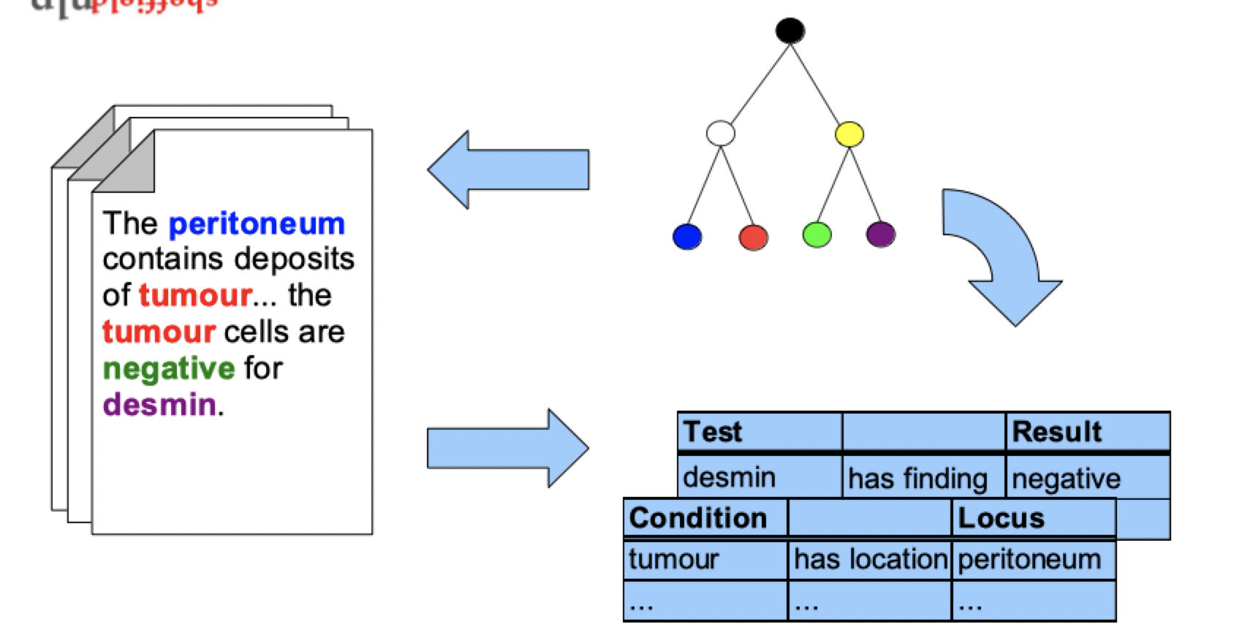
Entity linking

Slide 16
This half-day session
Introduce some of the basic ideas behind natural language processing
Give intuitive explanations for these ideas
Make NLP a little bit less of a black box within hidden workings
Introduce some health use cases

Slide 17
This half-day session
How do we represent or model language in the computer?
How do we train or supervise the computer to solve problems involving language?
What can we use NLP of the health record for?

Slide 18
Content
Presentations explaining the key ideas
Examples and demonstrations to illustrate these ideas
Some practicals use the Python programming language. Don’t worry – you don’t need to know Python to follow them
A demo of a working system
A presentation of some real-world use cases

Slide 19
Course material
All material can be found on GitHub
Let’s take a look:
http://bit.ly/4pKxAJa

Slide 20
Thank you
angus.roberts@kcl.ac.uk https://www.kcl.ac.uk/people/angus-roberts

